Slide 1
Unit 1
Problems

Slide 4
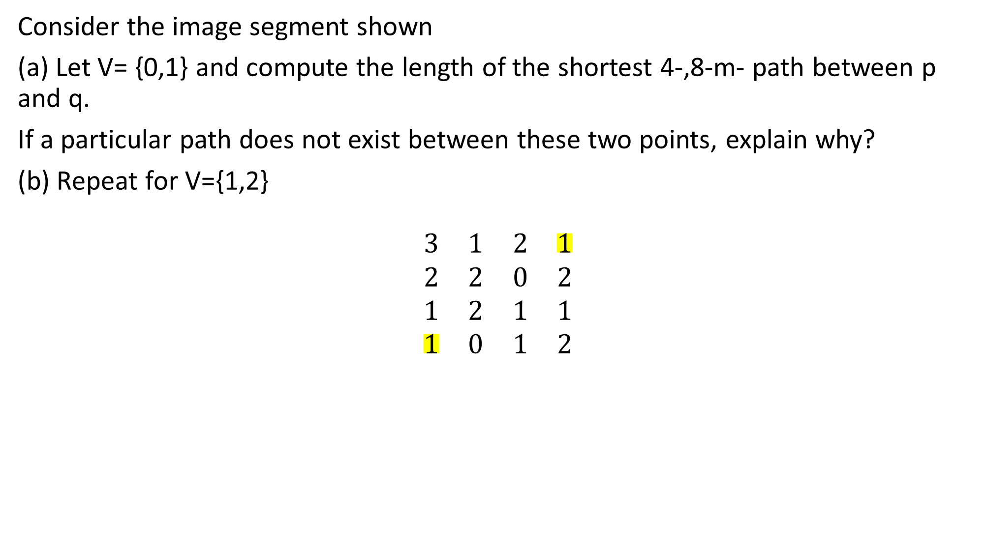
Consider the image segment shown
(a) Let V= {0,1} and compute the length of the shortest 4-,8-m- path between p and q.
If a particular path does not exist between these two points, explain why?
(b) Repeat for V={1,2}
$$\begin{matrix}3 & 1 & 2 & 1 \\ 2 & 2 & 0 & 2 \\ 1 & 2 & 1 & 1 \\ 1 & 0 & 1 & 2\end{matrix}$$

Slide 5
4 path
8 path and m-path (--->)

Slide 6
4 path
8 path and m-path (--->)

